Slide 1
Contents
Data Link Layer Design Issues
Error Detection and Correction
Elementary Data Link Protocols
Sliding Window Protocols
Example Data Link Protocols

Slide 2

Responsible for delivering frames of information over a single link
Handles transmission errors and regulates the flow of data
Application
Transport
Network
Link
Physical

Slide 3
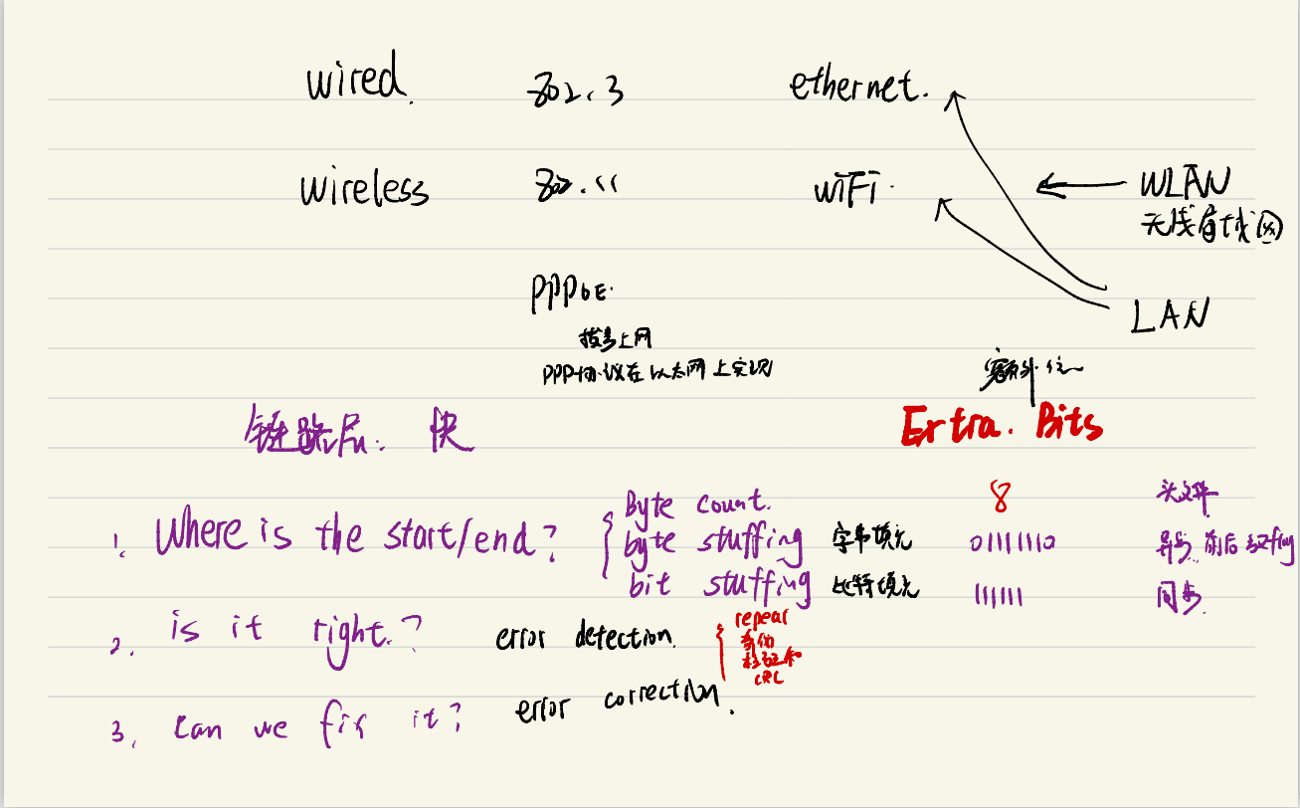

Slide 4
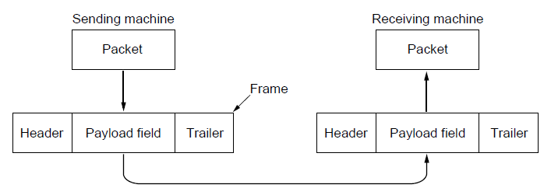
Frame
Link layer accepts packets from the network layer, and encapsulates them into frames that it sends using the physical layer; reception is the opposite process
Network
Link
Virtual data path
Physical
Actual data path

Slide 5
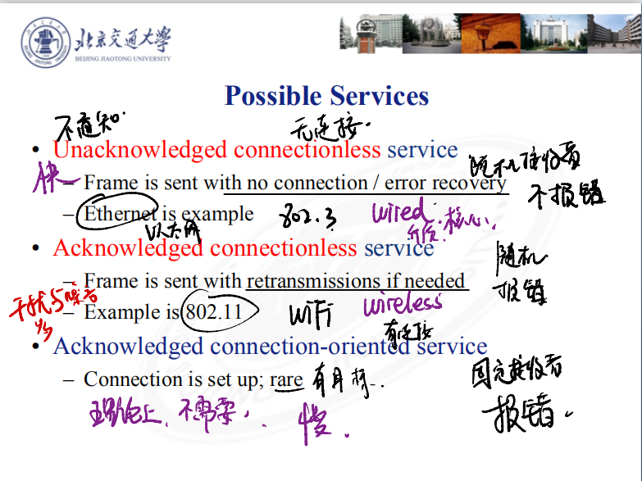
Possible Services
Unacknowledged connectionless service
Frame is sent with no connection / error recovery
Ethernet is example
Acknowledged connectionless service
Frame is sent with retransmissions if needed
Example is 802.11
Acknowledged connection-oriented service
Connection is set up; rare

Slide 6
Frame Methods
Byte count »
Flag bytes with byte stuffing »
Flag bits with bit stuffing »
Physical layer coding violations
Use non-data symbol to indicate frame

Slide 7
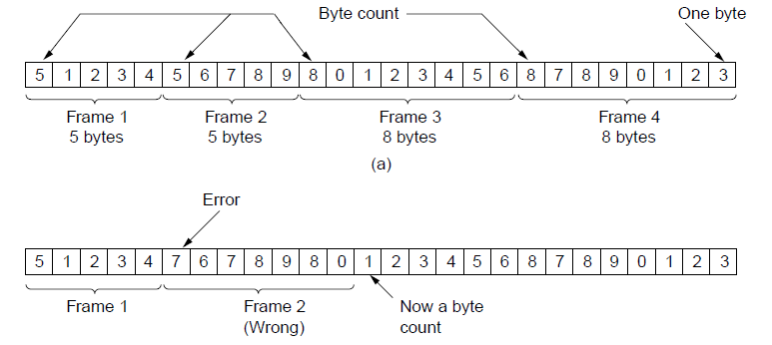
Framing-Byte Count
Frame begins with a count of the number of bytes in it
Simple, but difficult to resynchronize after an error
Expected
case
Error
case

Slide 8
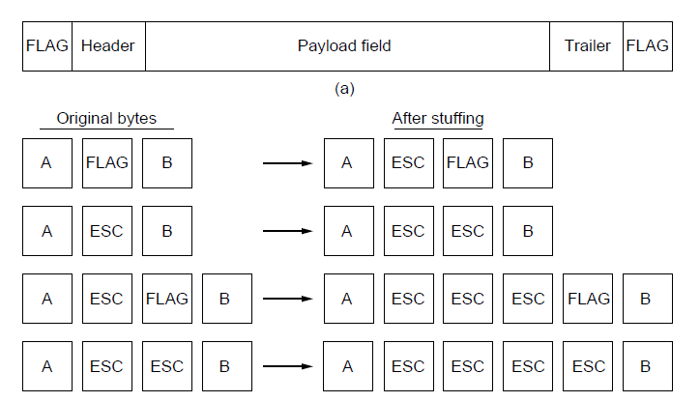
Framing-Byte Stuffing
Special flag bytes delimit frames; occurrences of flags in the data must be stuffed (escaped)
Longer, but easy to resynchronize after error
Frame
format
Need to escape extra ESCAPE bytes too!
Stuffing
examples

Slide 9
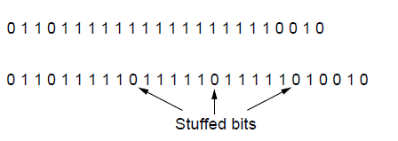
Framing-Bit Stuffing
Stuffing done at the bit level:
Frame flag has six consecutive 1s (not shown)
On transmit, after five 1s in the data, a 0 is added
On receive, a 0 after five 1s is deleted
Data bits
Transmitted bits
with stuffing

Slide 10
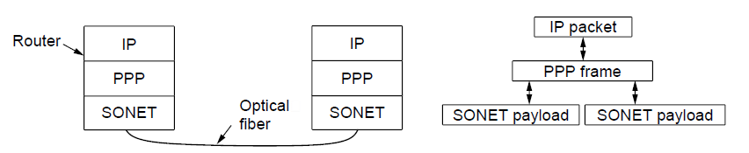
Example Protocol: PPP
Packet over SONET(Synchronous Optical Network) is the method used to carry IP packets over SONET optical fiber links
Uses PPP (Point-to-Point Protocol) for framing
Protocol stacks
PPP frames may be split over SONET payloads

Slide 11
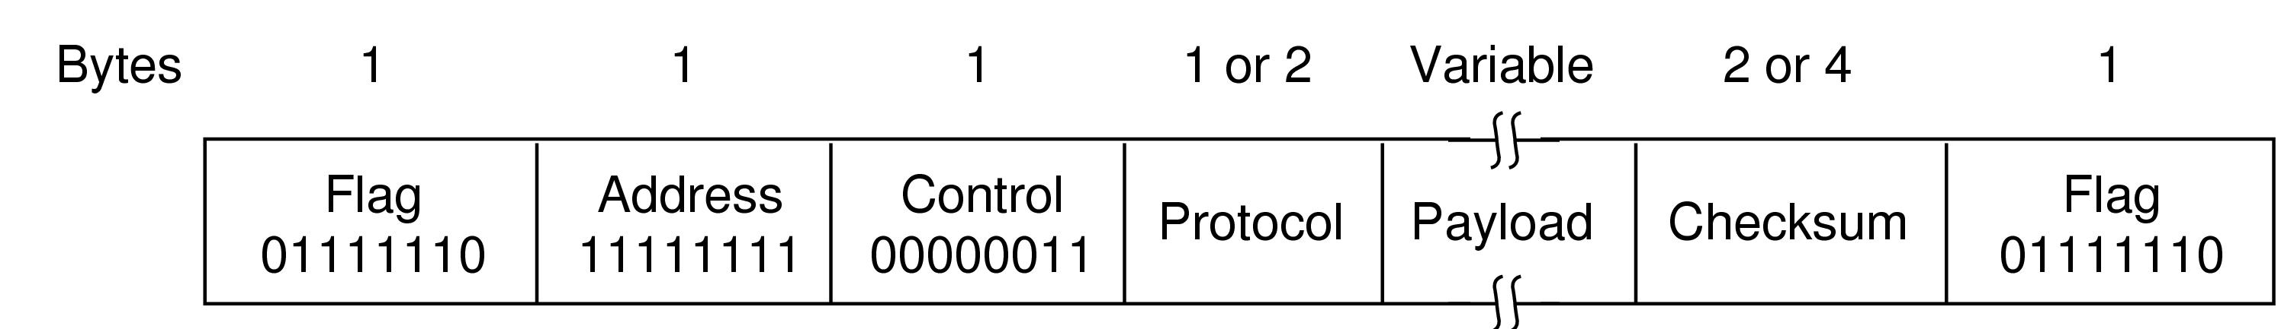
Example Protocol: PPP
PPP (Point-to-Point Protocol) is a general method for delivering packets across links
Framing uses a flag (0x7E) and (byte stuffing in Asynchronous Transmission Mode) and (bit stuffing in Synchronous Transmission Mode)
“Unnumbered mode” (connectionless unacknowledged service) is used to carry IP packets
Errors are detected with a checksum
0x21 for IPv4
IP packet

Slide 12
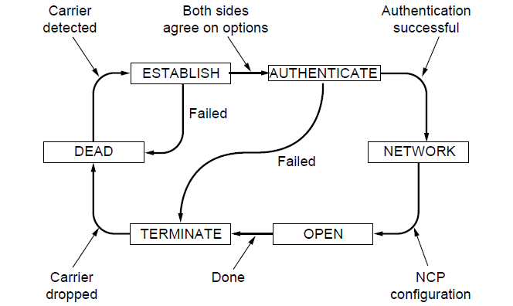
Example Protocol: PPP
A link control protocol brings the PPP link up/down
State machine for link control

Slide 13
Error Control
Error control repairs frames that are received in error
Requires errors to be detected at the receiver
Typically retransmit the unacknowledged frames
Timer protects against lost acknowledgements
Detecting errors and retransmissions are next topics.

Slide 14
Flow Control
Prevents a fast sender from out-pacing a slow receiver
Receiver gives feedback on the data it can accept
Rare in the Link layer as NICs run at “wire speed”
Receiver can take data as fast as it can be sent
Flow control is a topic in the Link and Transport layers.

Slide 15
Error detection and Correction
Error detection codes
Add check bits to the message bits to let some errors be detected
Error correction codes
Add more check bits to let some errors be corrected
Key issue is now to structure the code to detect many errors with few check bits and modest computation

Slide 16
Error detection and Correction
We want to handle more errors with less overhead
Will look at better codes; they are applied mathematics
But, they can’t handle all errors
And they focus on accidental errors (will look at secure hashes later)

Slide 17
Error detection and Correction
Error codes add structured redundancy to data so errors can be either detected, or corrected.
Error detection codes:
Parity »
Checksums »
Cyclic Redundancy Codes (CRC) »
Error correction codes:
Hamming codes »
Binary convolutional codes »
Reed-Solomon and Low-Density Parity Check codes

Slide 18
Error Detection-Parity
Parity bit is added as the modulo 2 sum of data bits
Equivalent to XOR; this is even parity
Ex: 1110000 → 11100001
Detection checks if the sum is wrong (an error)
Simple way to detect an odd number of errors
Ex: 1 error, 11100101; detected, sum is wrong
Ex: 3 errors, 11011001; detected sum is wrong
Ex: 2 errors, 11101101; not detected, sum is right!
Error can also be in the parity bit itself
Random errors are detected with probability ½

Slide 19
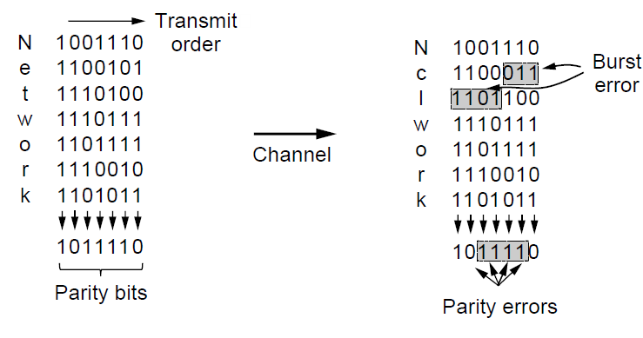
Error Detection-Parity
Interleaving of N parity bits detects burst errors up to N
Each parity sum is made over non-adjacent bits
An even burst of up to N errors will not cause it to fail

Slide 20
Error Detection-Checksums
Checksum treats data as N-bit words and adds N check bits that are the modulo 2^{N} sum of the words
Ex: Internet 16-bit 1s complement checksum
Properties:
Improved error detection over parity bits
Detects bursts up to N errors
Detects random errors with probability 1-2^{N}
Vulnerable to systematic errors, e.g., added zeros

Slide 21
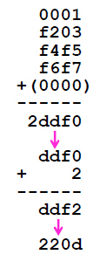
Error Detection-Checksums
Sending:
1. Arrange data in 16-bit words
2. Put zero in checksum position, add
3. Add any carryover back to get 16 bits
4. Negate (complement) to get sum

Slide 22

Error Detection-Checksums
Receiving:
1.Arrange data in 16-bit words
2.Checksum will be non-zero, add
3.Add any carryover back to get 16 bits
4.Negate the result and check it is 0

Slide 23
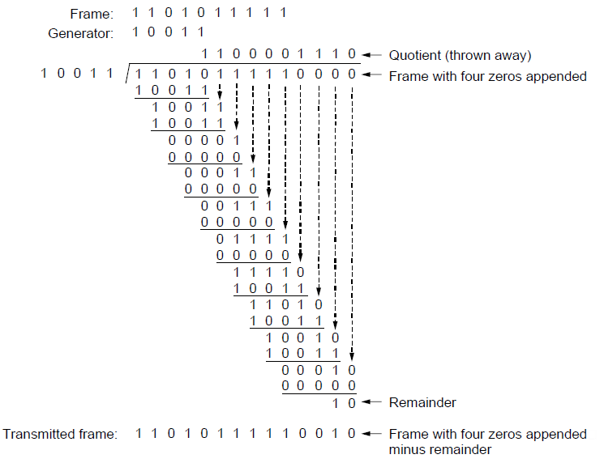
Error Detection-CRC
Adds bits so that transmitted frame viewed as a polynomial is evenly divisible by a generator polynomial
Start by adding 0s to frame and try dividing
Offset by any reminder to make it evenly divisible

Slide 24
Error Detection-CRC
Based on standard polynomials:
Ex: Ethernet 32-bit CRC is defined by:
Computed with simple shift/XOR circuits
Stronger detection than checksums:
E.g., can detect all double bit errors
Not vulnerable to systematic errors

Slide 25
Error Correction and Detection
Error detection:
– More efficient when errors are not expected
– And when errors are large when they do occur
Error correction:
– Needed when errors are expected
– Or when no time for retransmission

